Slide 1
Summer Project Update –
Playgrounds and Classroom Furniture
February 23, 2023
Micheal DeBartolo

Slide 2
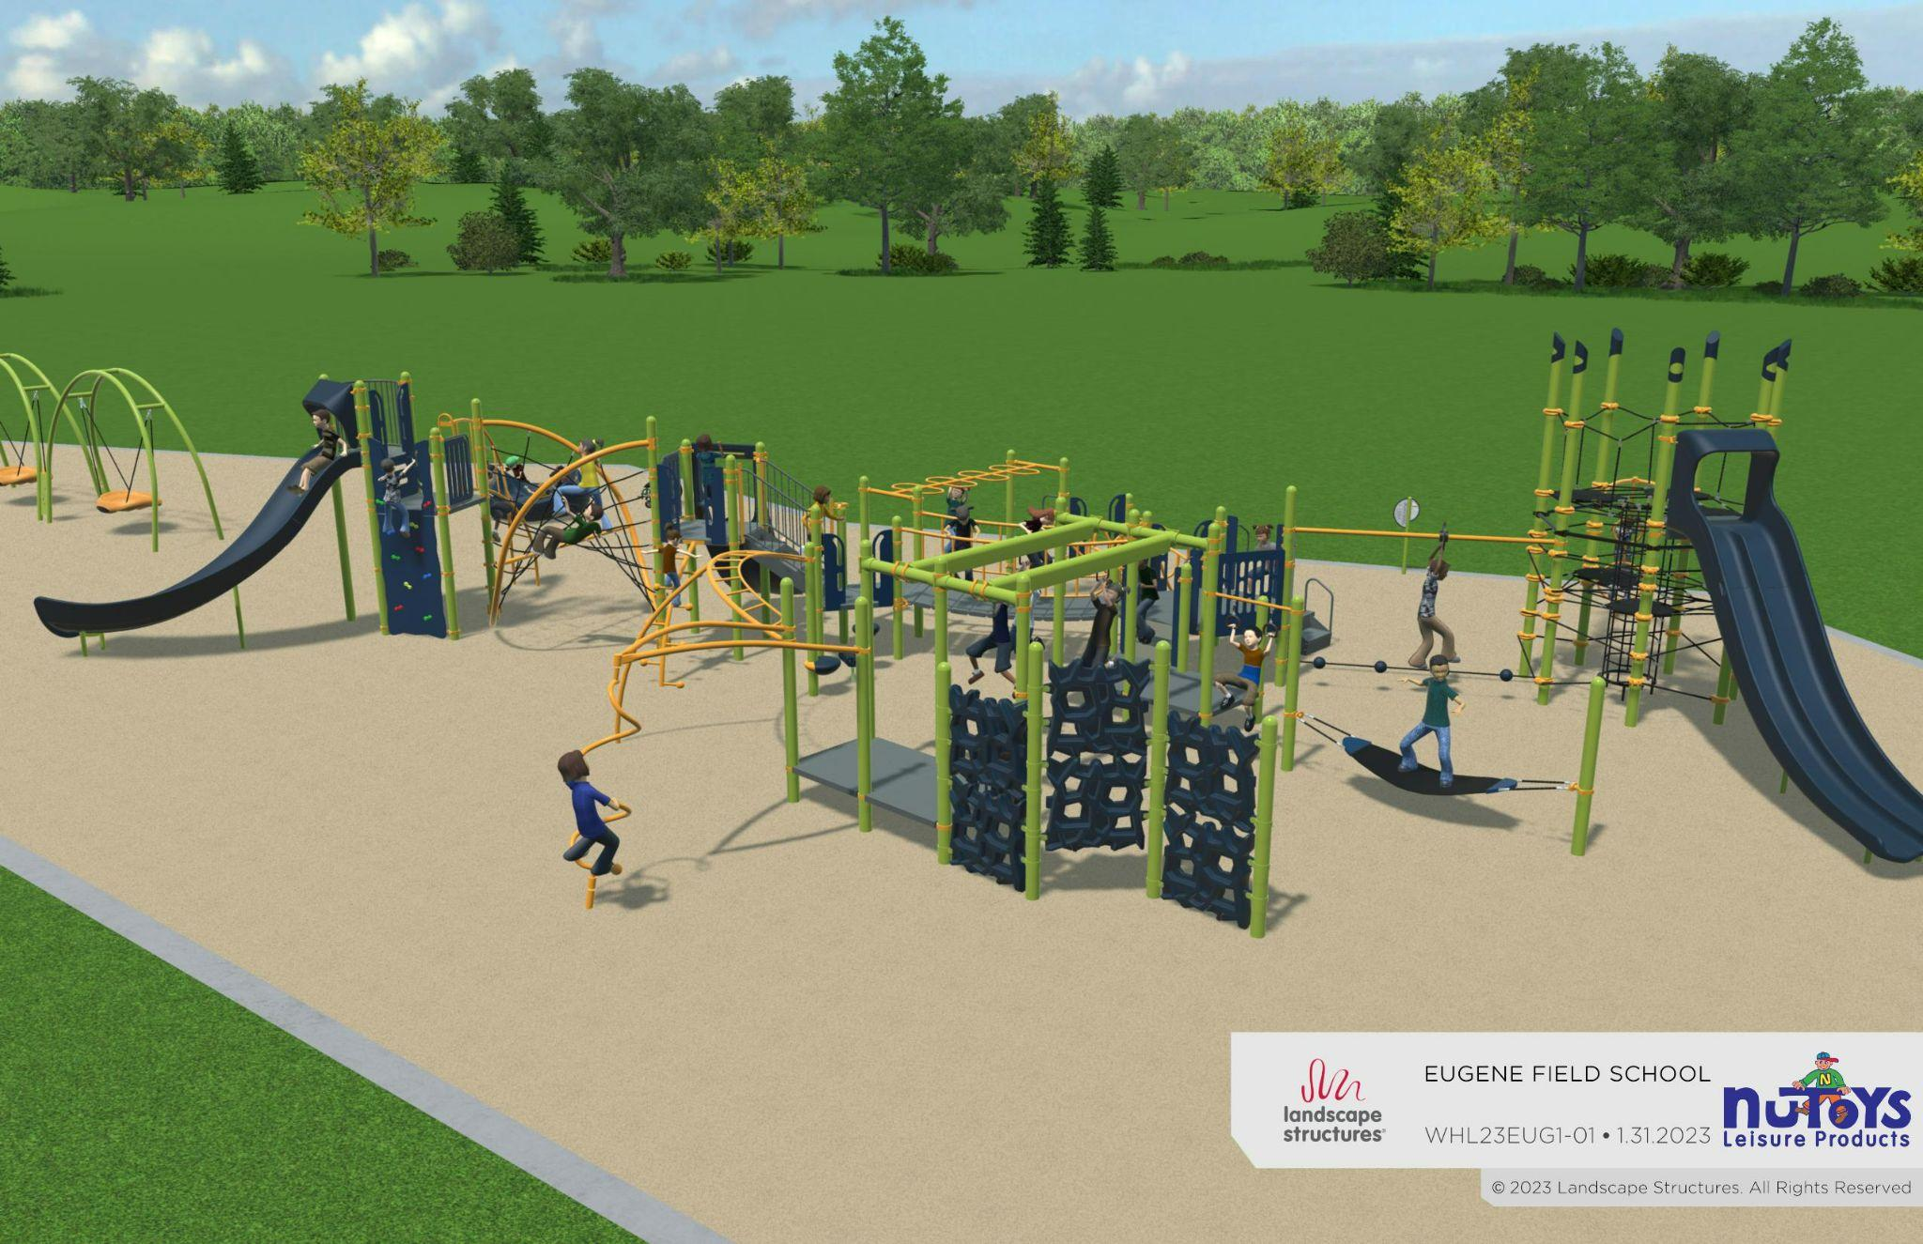
Field Playground (View 1)

Slide 3
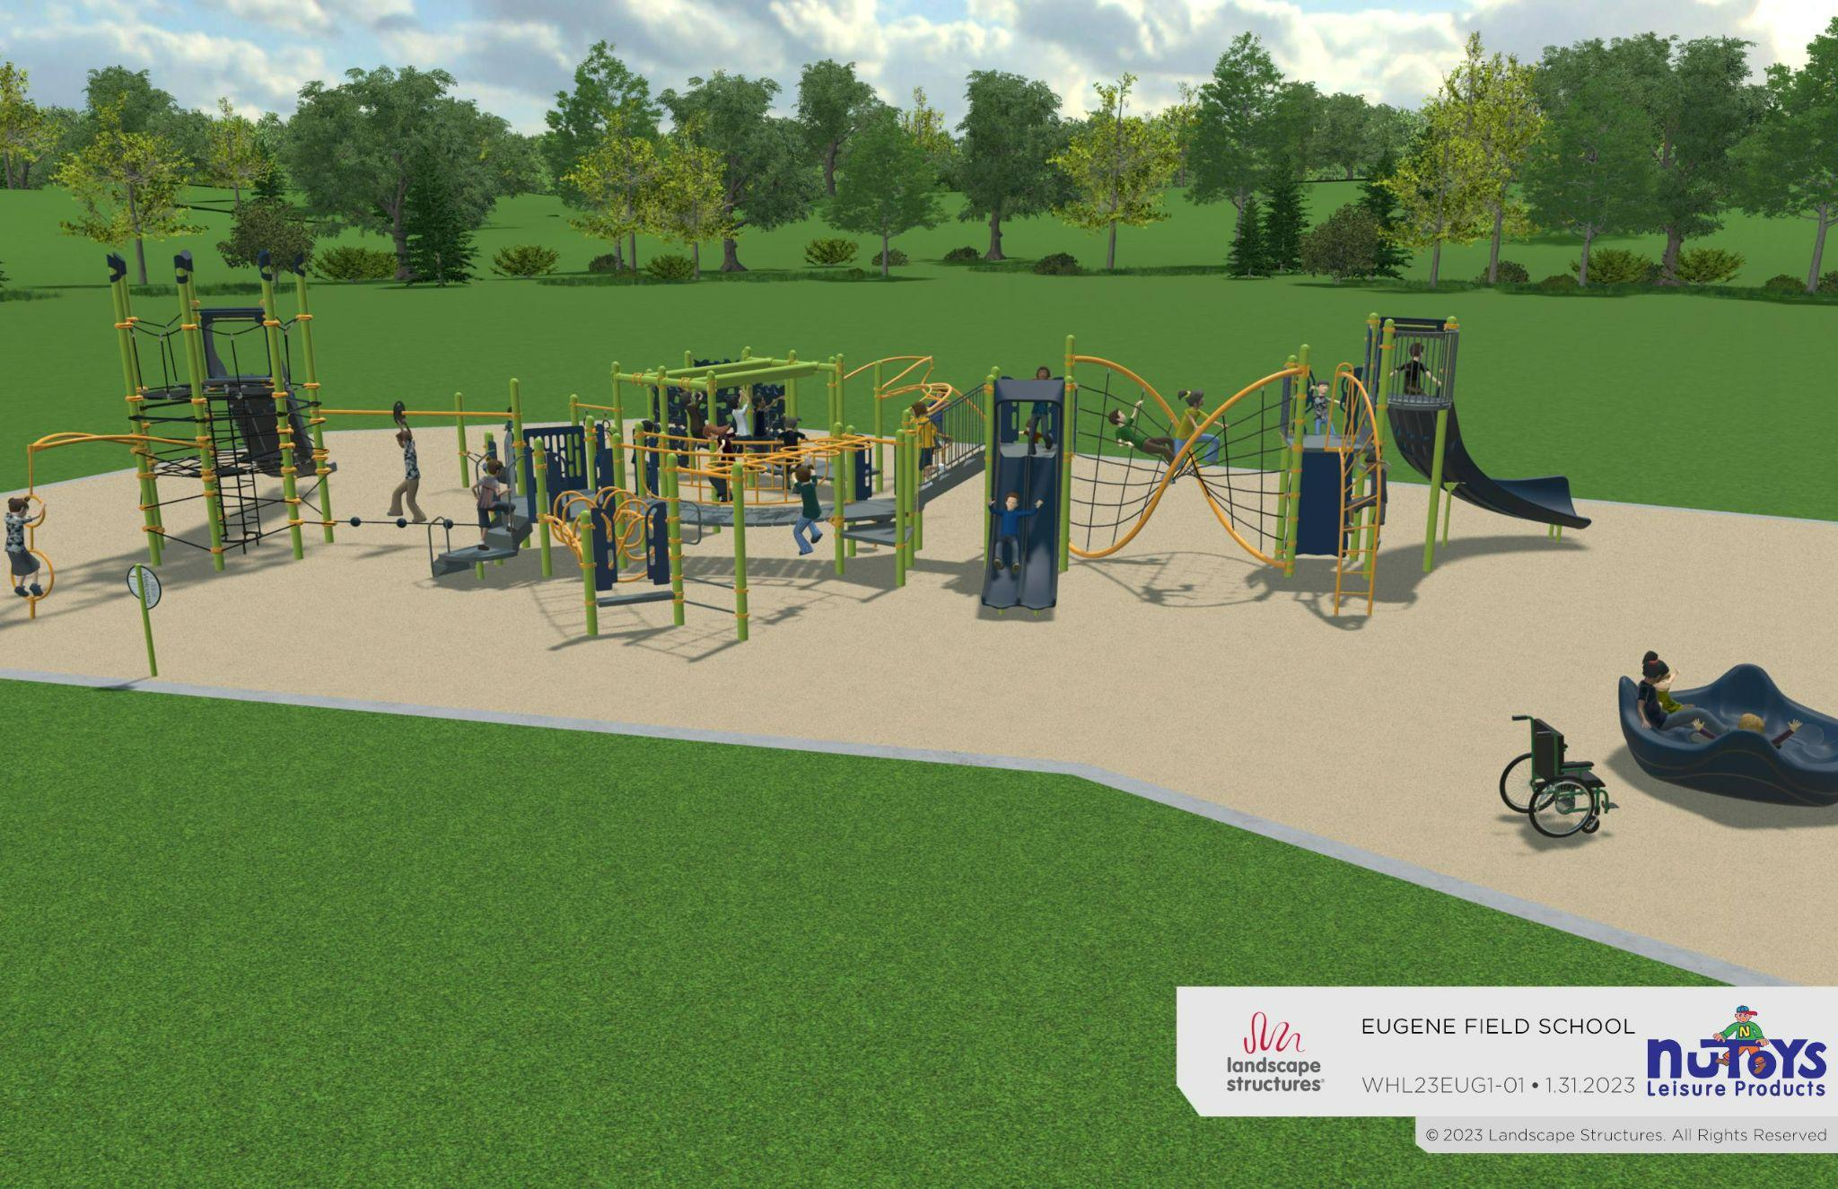
Field Playground (View 2)

Slide 4
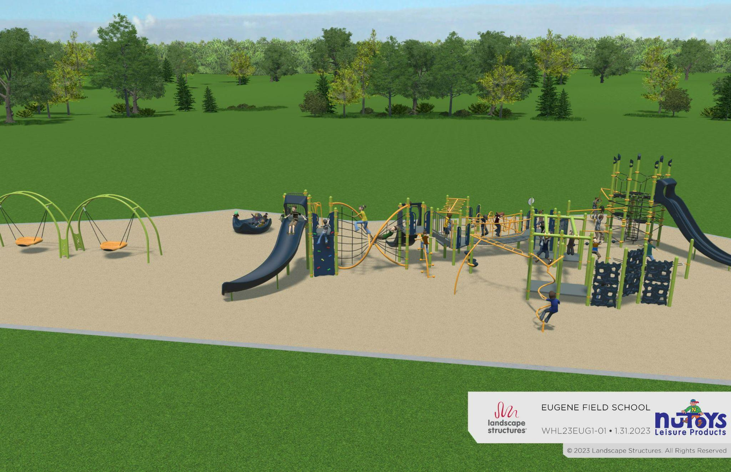
Field Playground (View 3)

Slide 5
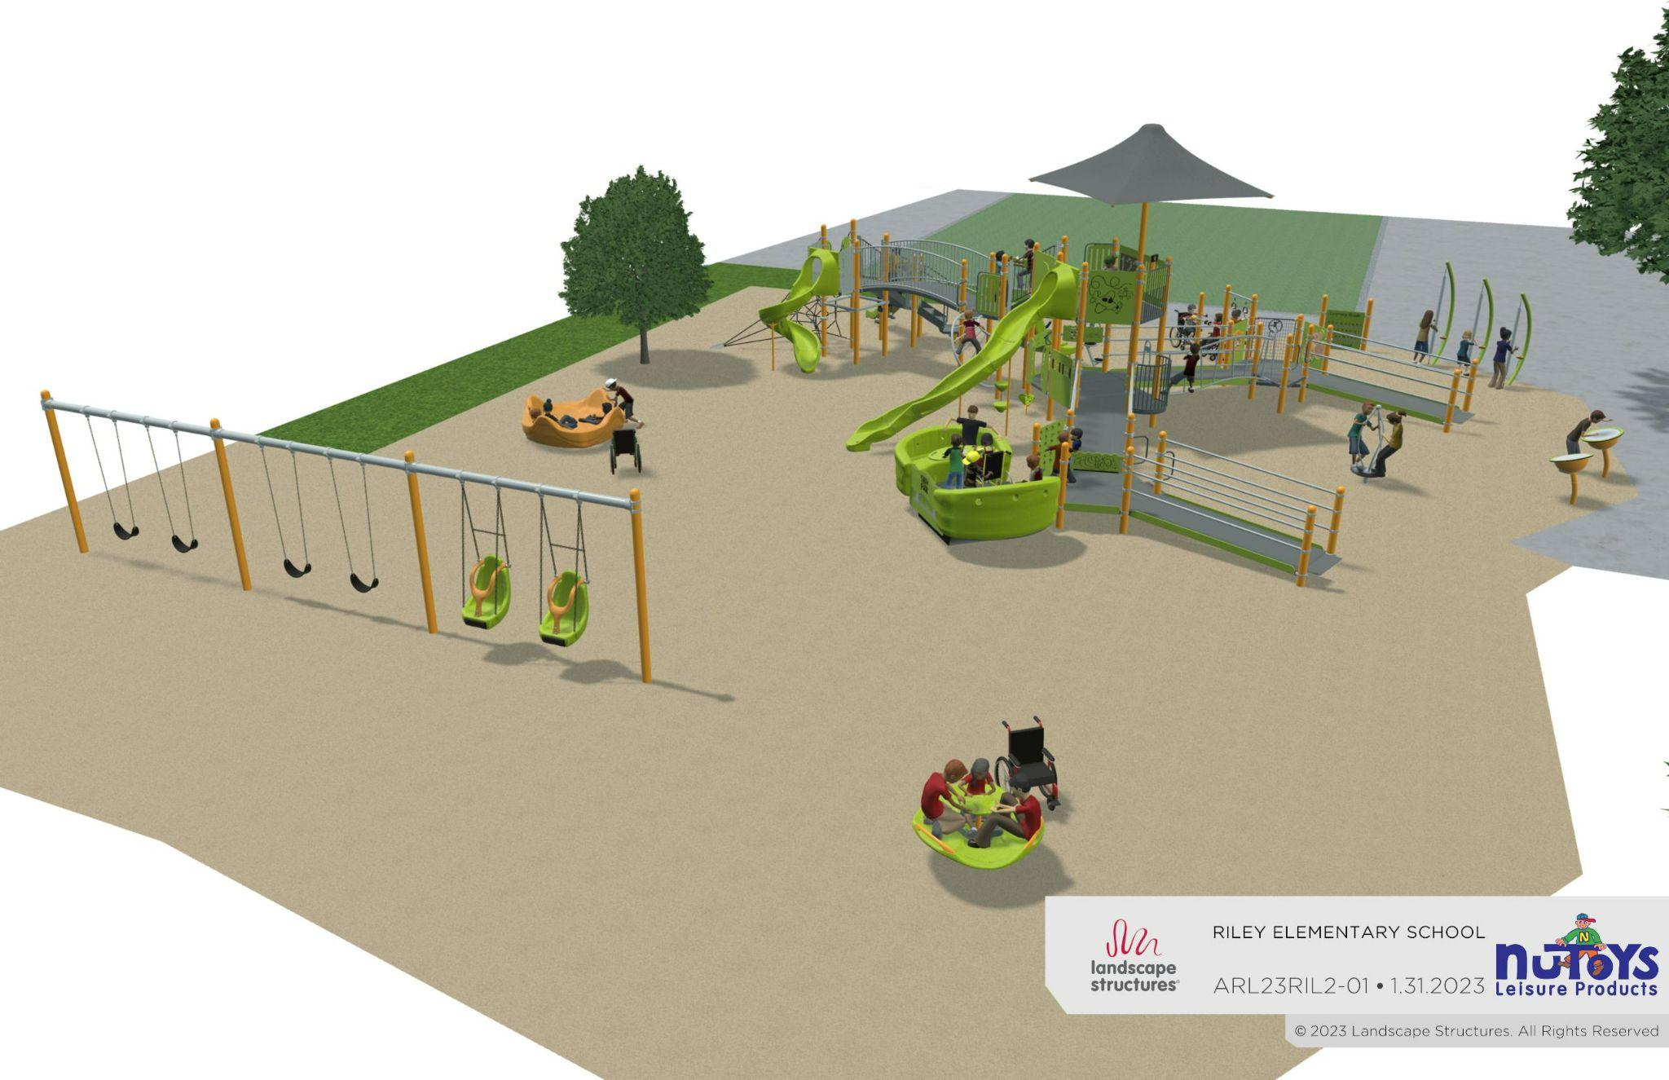
Riley Playground (View 1)

Slide 6
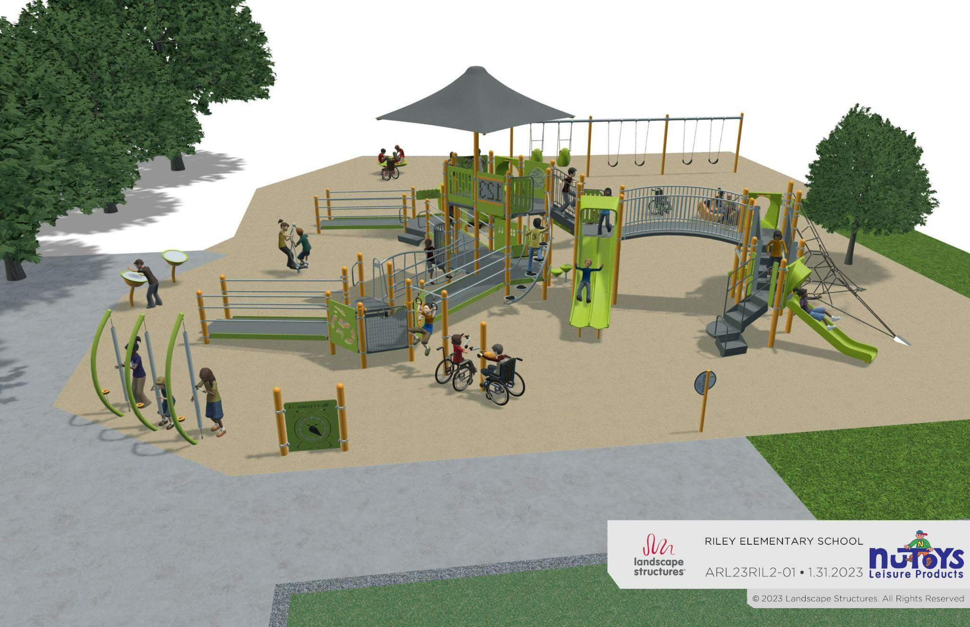
Riley Playground (View 2)

Slide 7
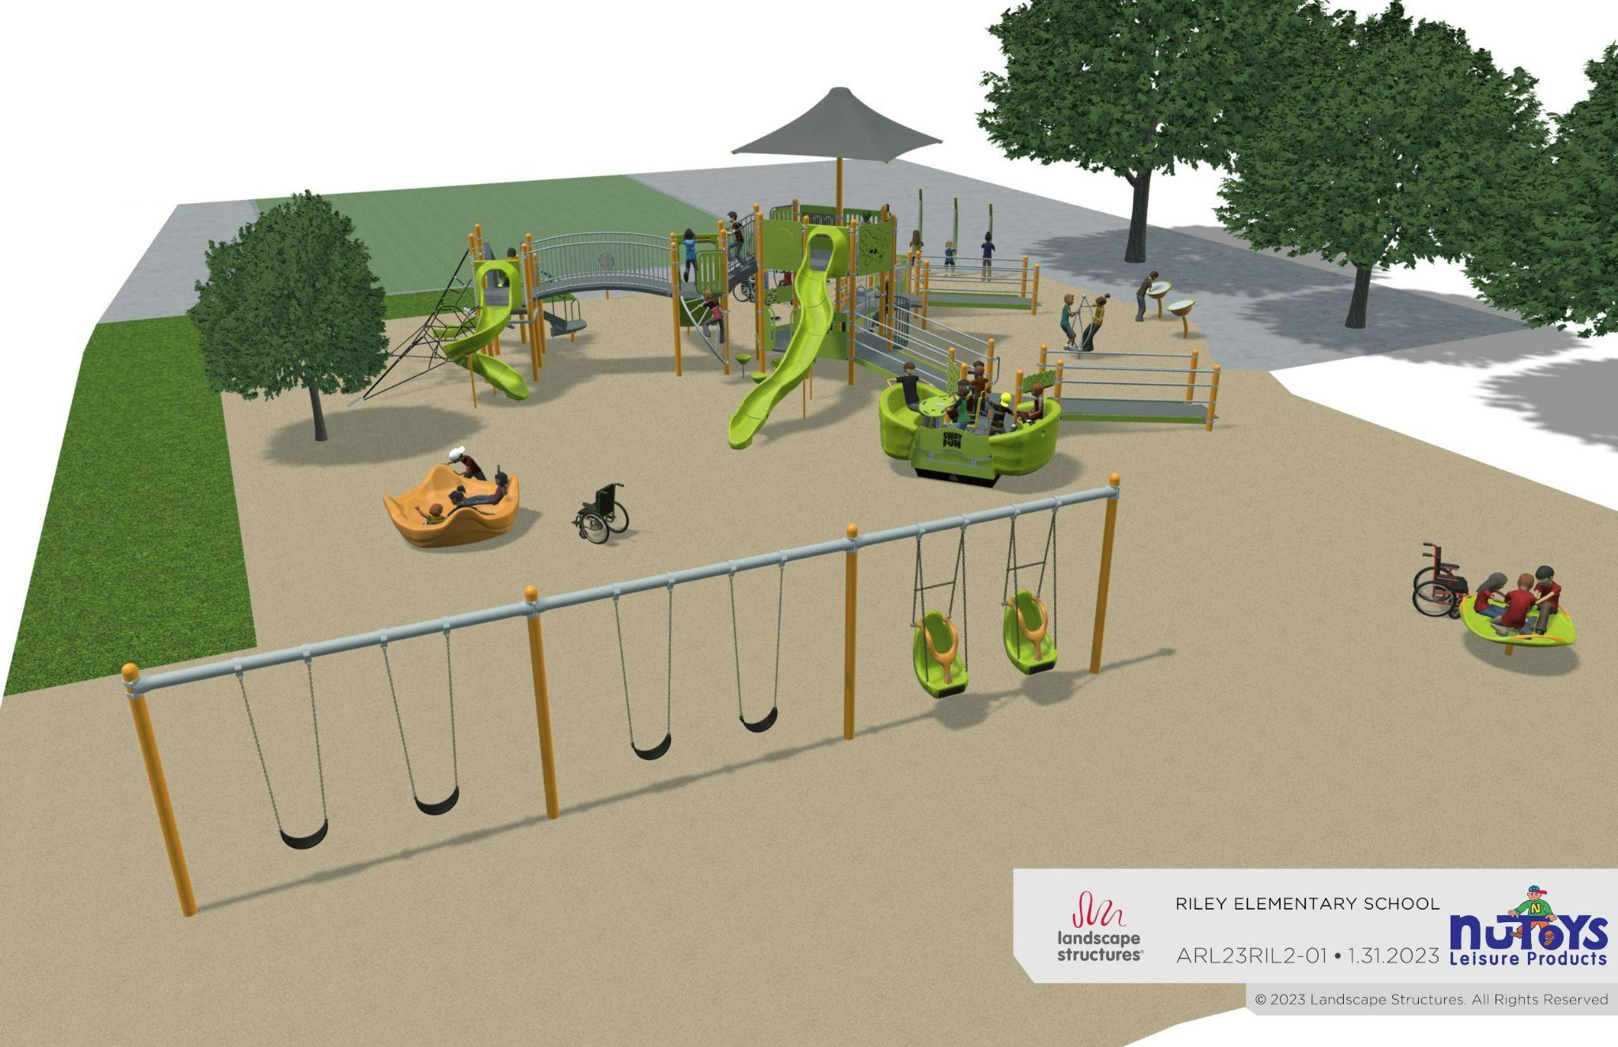
Riley Playground (View 3)

Slide 8
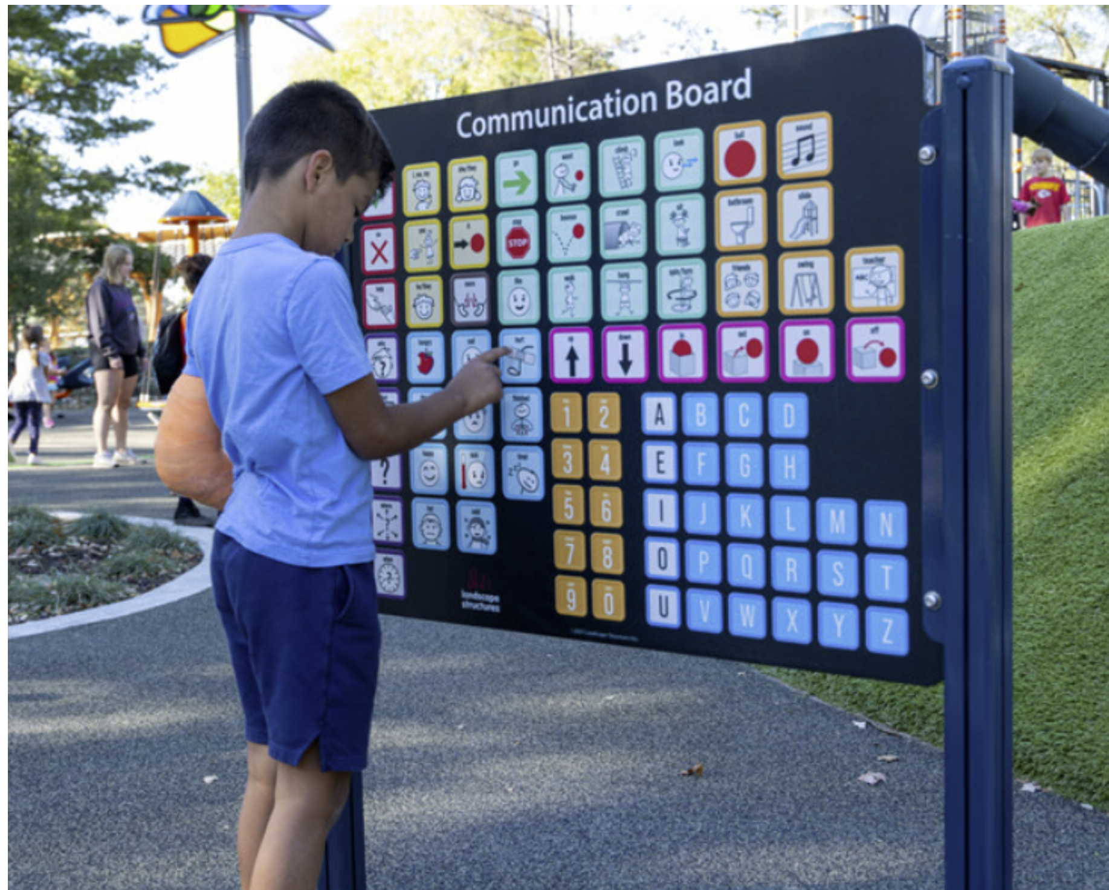
Riley Communication Board

